Slide 1
SALES ANALYSIS DASHBOARD
Project Type: Data Analysis Project
Tools Used : Excel
Presented by: Vidhya

Slide 2
Overview
→ This project analyzes sales data using Microsoft Excel.
→ The dataset contains 500 sales orders.
The analysis focuses on products, categories, regions, customers, and monthly sales.
→ An interactive dashboard was created using PivotTables, Charts, and.
Slicers
→ The dashboard helps identify sales trends and business performance.

Slide 3
Objectives
Analyze overall sales performance.
Identify the highest-selling products.
→ Compare sales across different categories.
→ Analyze regional sales performance.
→ Identify monthly sales trends.
→ Find top-performing customers.
→ Create an interactive sales dashboard.
→ Generate useful business insights.

Slide 4
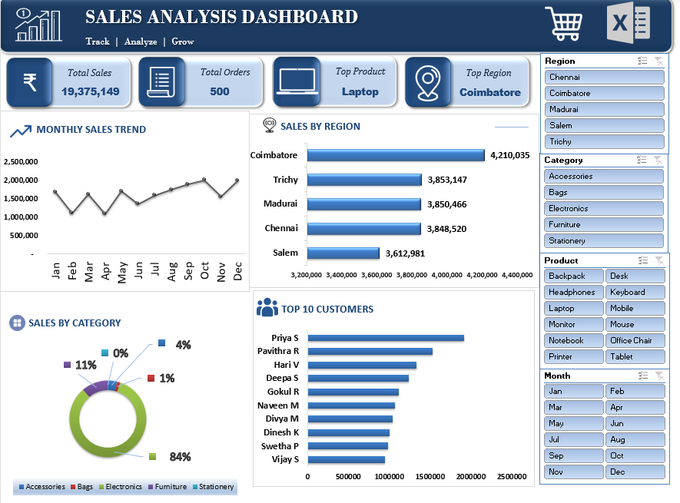

Key Results
Total Sales: ₹19,375,149
Total Orders: 500
Top Product: Laptop – ₹6,425,463
Top Category: Electronics – ₹16,170,921
Top Region: Coimbatore – ₹4,210,035
Top Month: October – ₹2,012,022
Top Customer: Priya S – ₹1,917,906

Slide 5
Advantage
Easy Data Analysis
Interactive Dashboard
Clear Visualization
Business Insights
Easy to Use

Slide 6
Disadvantage Solutions
Limited Data Handling Use SQL / Power Bi
Manual Updates Refresh Use Excel Tables & Refresh
Collaboration Limitations Use OneDrive / Sharepoint
Security Limitations Use Password & Access Control
Advanced Analytics Limitations Use Python / Power Bi

Slide 7
Conclusion
Excel was used to transform raw sales data into meaningful insights.
PivotTables and PivotCharts helped analyze business performance.
Slicers made the dashboard interactive.
The dashboard provides a clear view of sales trends, products, customers, categories, and regions.
This project demonstrates practical Data Analysis and Excel Dashboard skills.

Slide 8
THANK YOU

